Slide 1




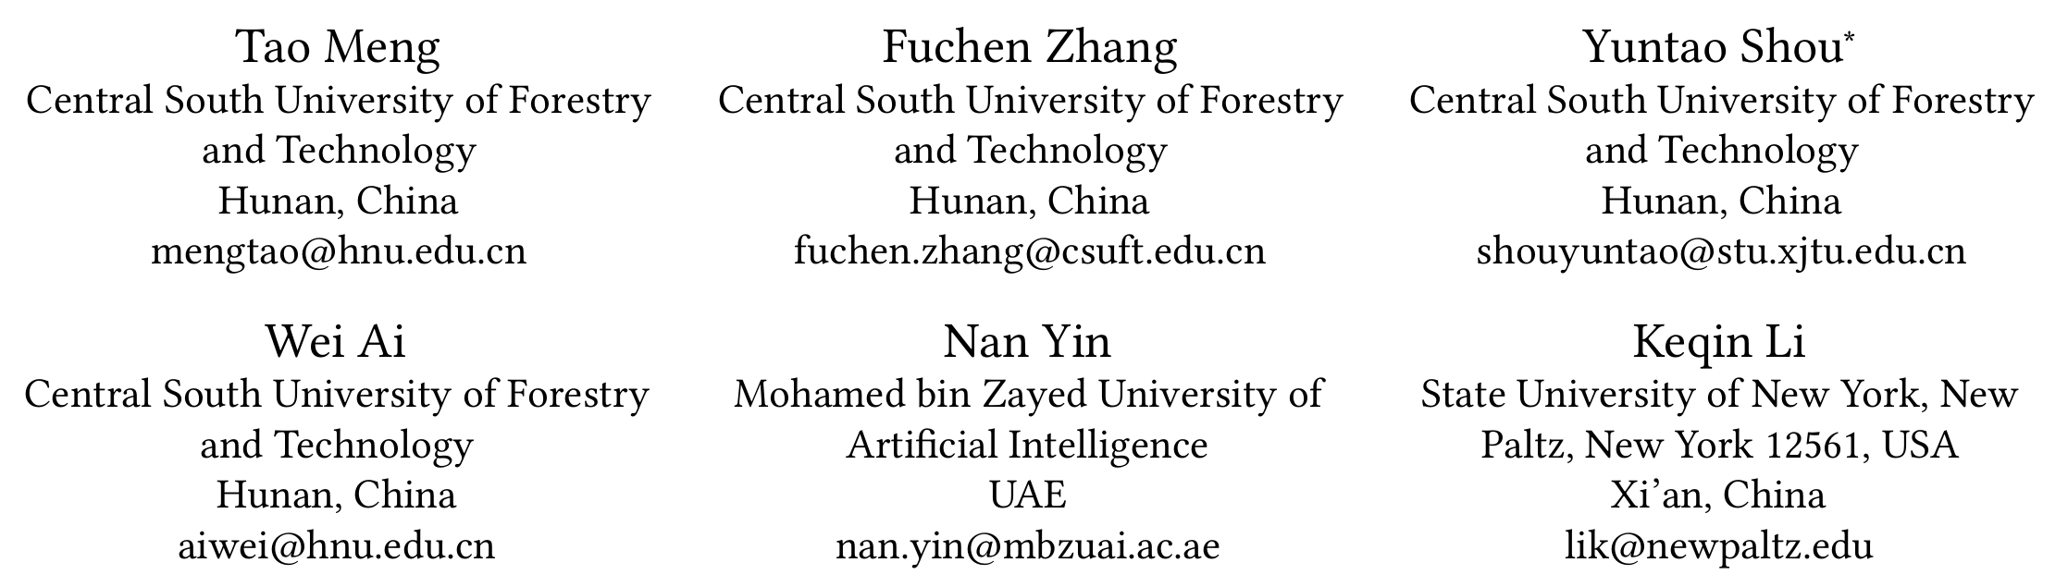





ATAI
Advanced Technique of Artificial Intelligence
ATAI
ChongqingUniversity _{AdvancedTechniqueof}
of Technology Artificial Intelligence
Chongqing University of
Technology
Chongqing University ^{ATAI}
_{of Technology} Advanced Techniqueof
Artificial Intelligence
Chongqing University of Technology
Chongqing University of Technology
Revisiting Multimodal Emotion Recognition in Conversation
from the Perspective of Graph Spectrum
Code : None.
—— AAAI’2025
Reported by Yang Jiang
1

Slide 2
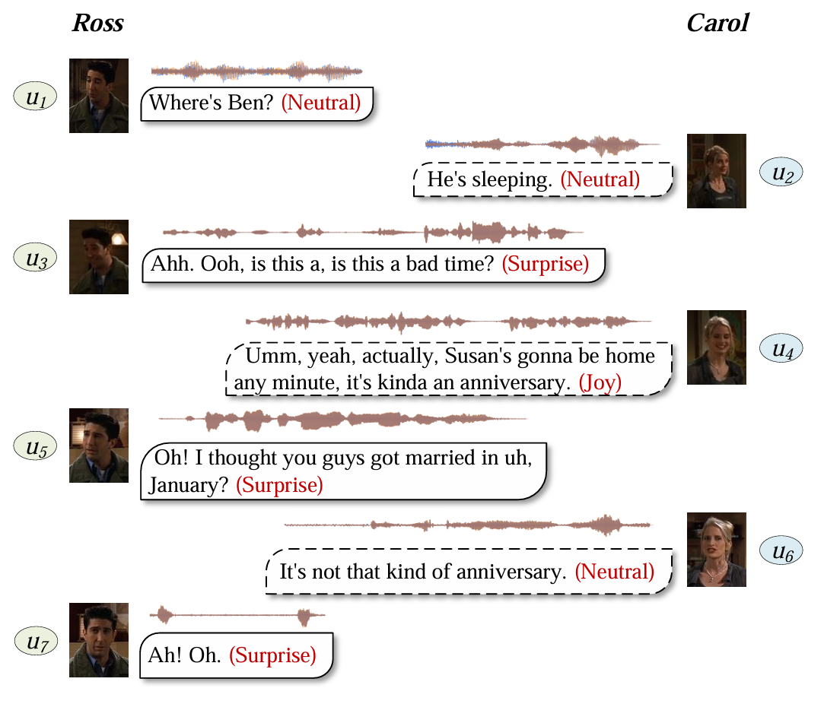
ATAI
Advanced Technique of Artificial Intelligence
ATAI
ChongqingUniversity _{AdvancedTechniqueof}
of Technology Artificial Intelligence
Chongqing University of
Technology
Chongqing University ^{ATAI}
_{of Technology} Advanced Techniqueof
Artificial Intelligence
Chongqing University of Technology
Chongqing University of Technology
Introduction
However,these methods are limited by some inherent characteristics of GNN,such as over-smoothing and low-pass filtering, resulting in the inability to learn long-distance consistency information and complementary information efficiently. Since consistency and complementarity information correspond to low-frequency and high-frequency information, respectively.

Slide 3
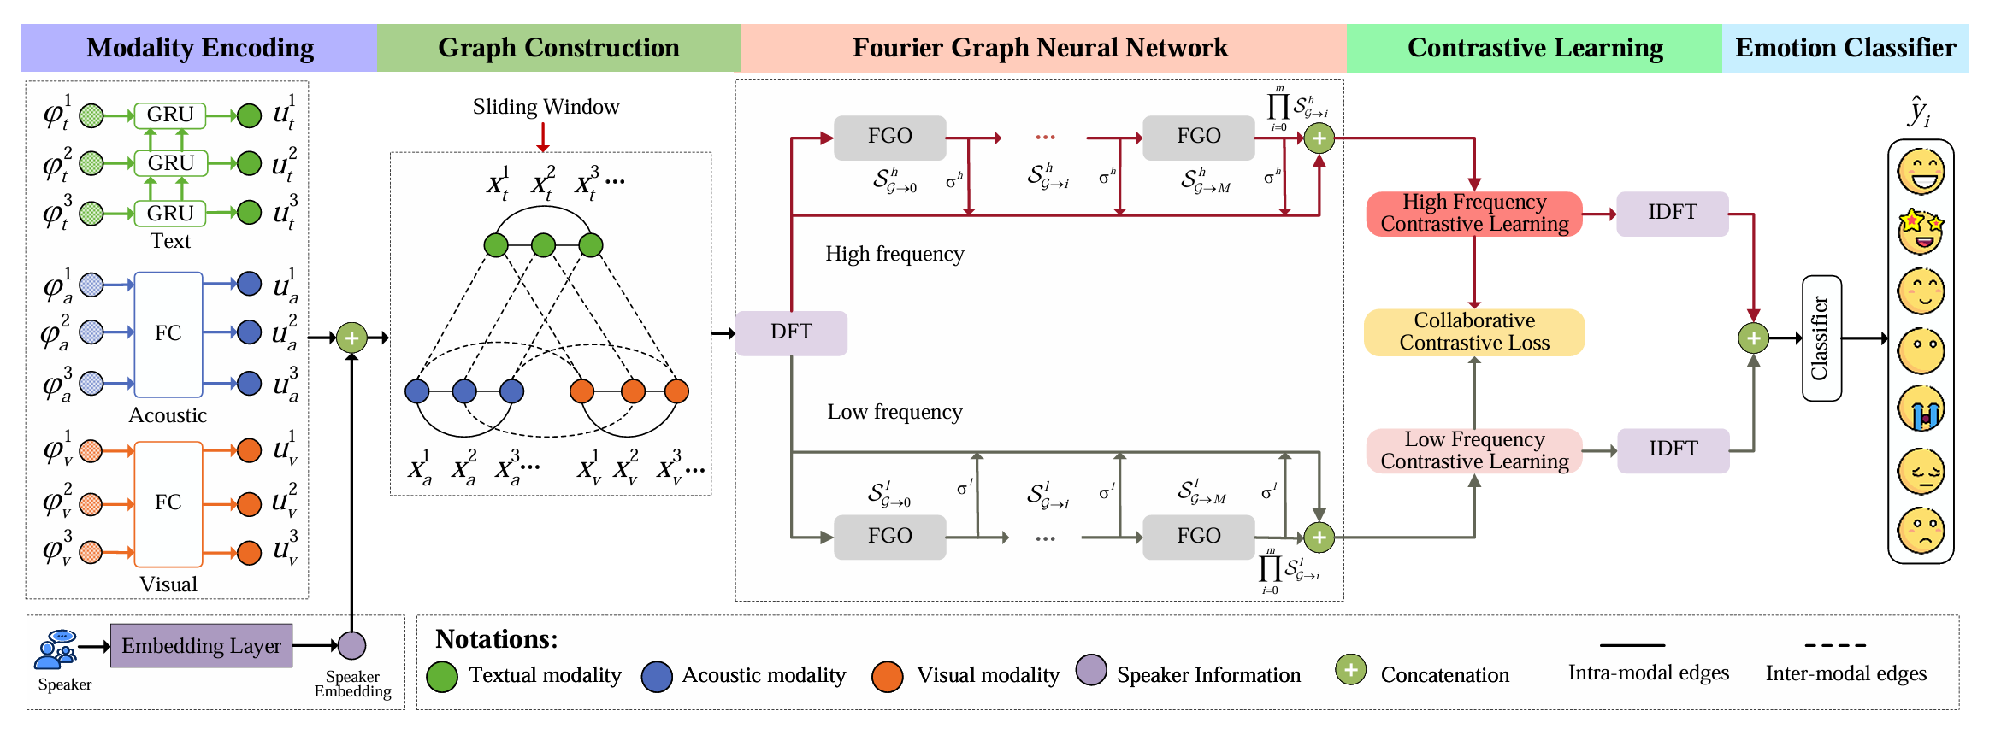
ATAI
Advanced Technique of Artificial Intelligence
ATAI
ChongqingUniversity _{AdvancedTechniqueof}
of Technology Artificial Intelligence
Chongqing University of
Technology
Chongqing University ^{ATAI}
_{of Technology} Advanced Techniqueof
Artificial Intelligence
Chongqing University of Technology
Chongqing University of Technology
Overview

Slide 4
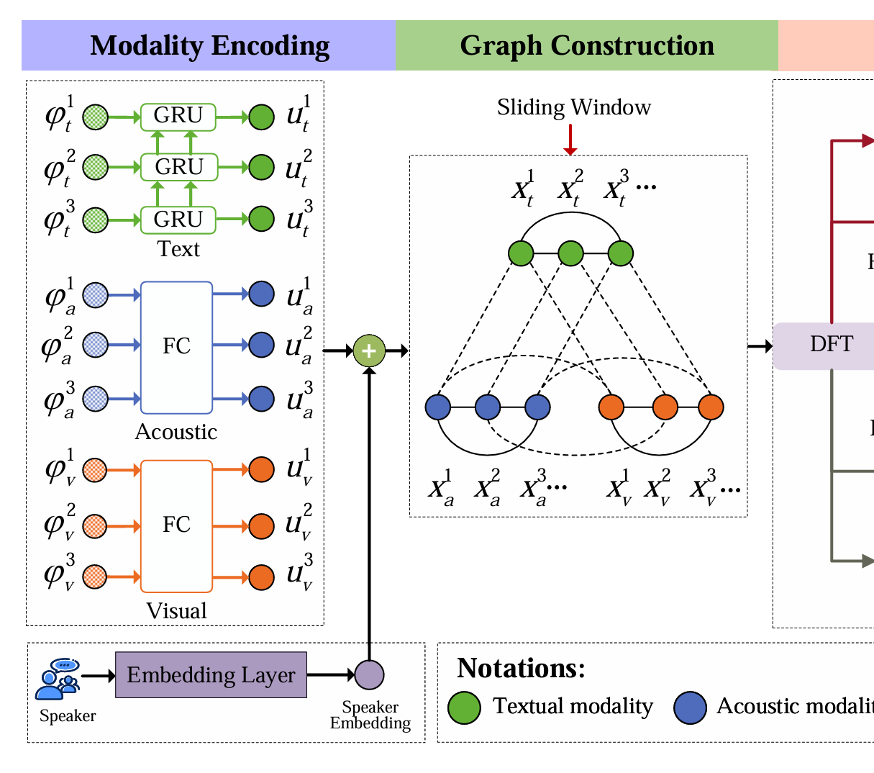
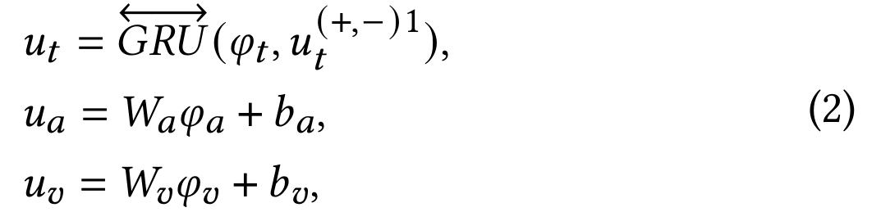
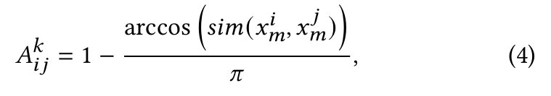
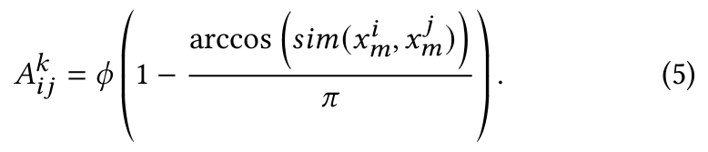
ATAI
Advanced Technique of Artificial Intelligence
ATAI
ChongqingUniversity _{AdvancedTechniqueof}
of Technology Artificial Intelligence
Chongqing University of
Technology
Chongqing University ^{ATAI}
_{of Technology} Advanced Techniqueof
Artificial Intelligence
Chongqing University of Technology
Chongqing University of Technology
Method

Slide 5

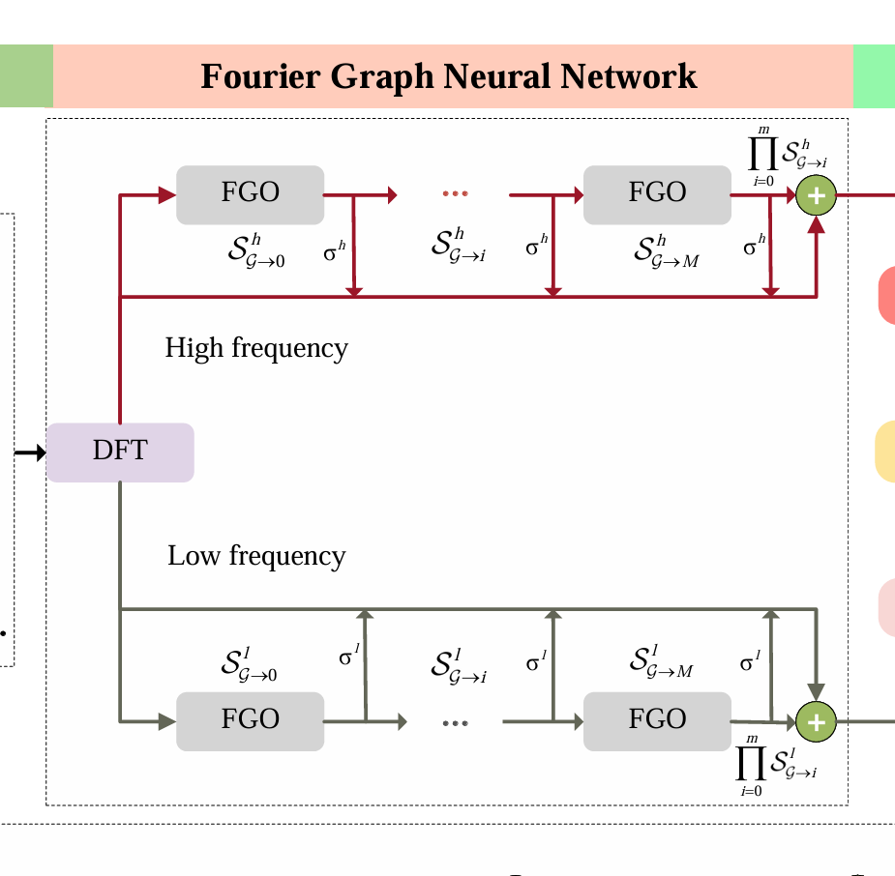


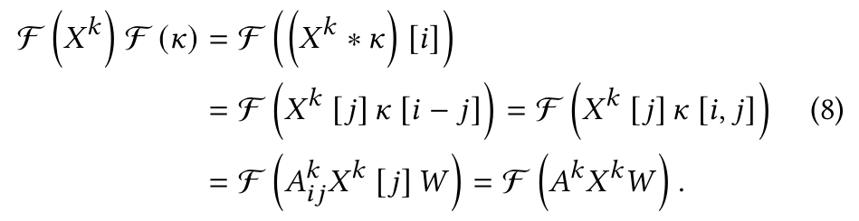
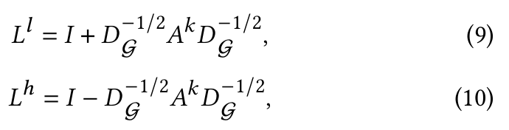
ATAI
Advanced Technique of Artificial Intelligence
ATAI
ChongqingUniversity _{AdvancedTechniqueof}
of Technology Artificial Intelligence
Chongqing University of
Technology
Chongqing University ^{ATAI}
_{of Technology} Advanced Techniqueof
Artificial Intelligence
Chongqing University of Technology
Chongqing University of Technology
Method

Slide 6


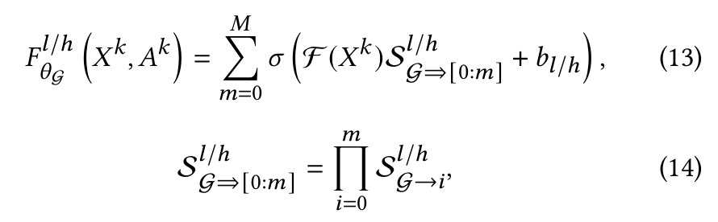
ATAI
Advanced Technique of Artificial Intelligence
ATAI
ChongqingUniversity _{AdvancedTechniqueof}
of Technology Artificial Intelligence
Chongqing University of
Technology
Chongqing University ^{ATAI}
_{of Technology} Advanced Techniqueof
Artificial Intelligence
Chongqing University of Technology
Chongqing University of Technology
Method

Slide 7
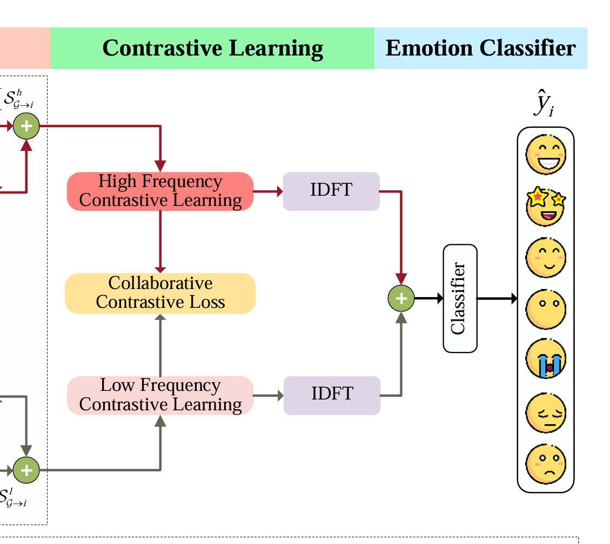
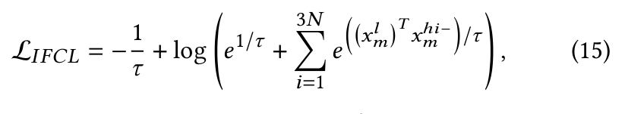
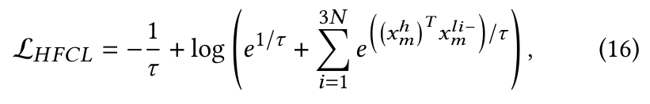


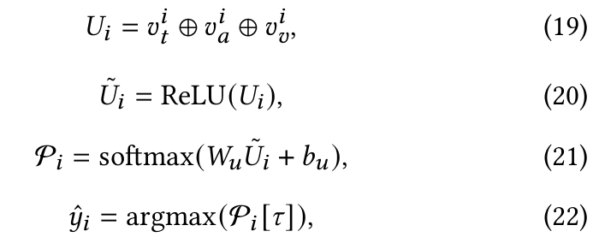
ATAI
Advanced Technique of Artificial Intelligence
ATAI
ChongqingUniversity _{AdvancedTechniqueof}
of Technology Artificial Intelligence
Chongqing University of
Technology
Chongqing University ^{ATAI}
_{of Technology} Advanced Techniqueof
Artificial Intelligence
Chongqing University of Technology
Chongqing University of Technology
Method

Slide 8
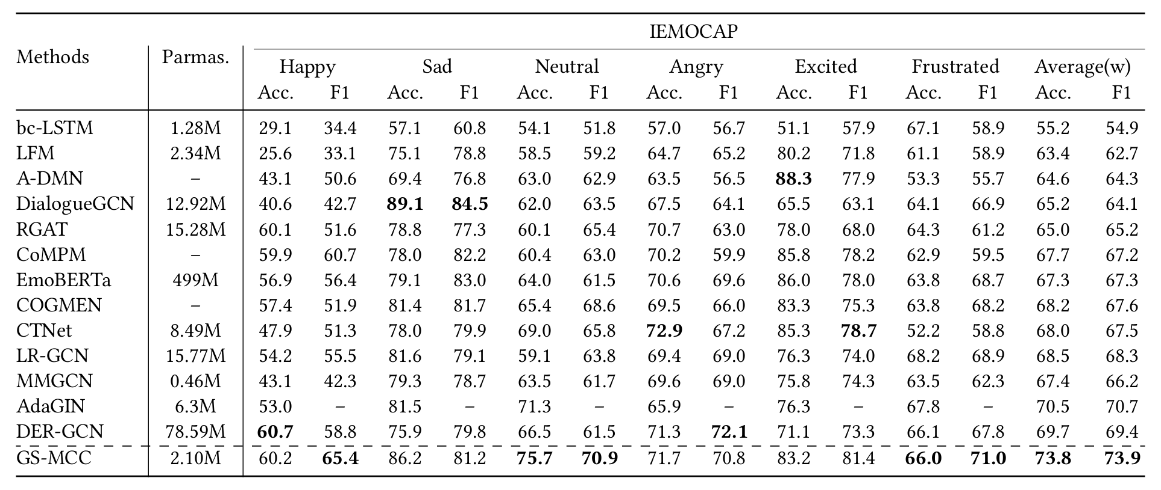
ATAI
Advanced Technique of Artificial Intelligence
ATAI
ChongqingUniversity _{AdvancedTechniqueof}
of Technology Artificial Intelligence
Chongqing University of
Technology
Chongqing University ^{ATAI}
_{of Technology} Advanced Techniqueof
Artificial Intelligence
Chongqing University of Technology
Chongqing University of Technology
Experiments

Slide 9
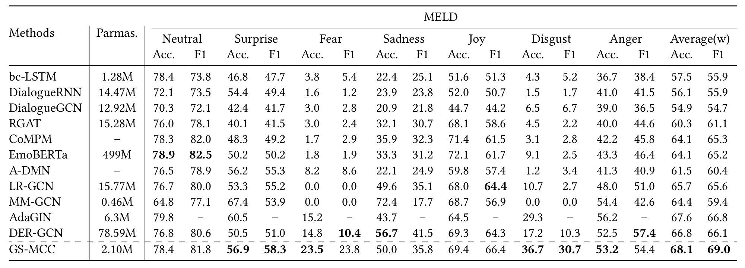
ATAI
Advanced Technique of Artificial Intelligence
ATAI
ChongqingUniversity _{AdvancedTechniqueof}
of Technology Artificial Intelligence
Chongqing University of
Technology
Chongqing University ^{ATAI}
_{of Technology} Advanced Techniqueof
Artificial Intelligence
Chongqing University of Technology
Chongqing University of Technology
Experiments

Slide 10
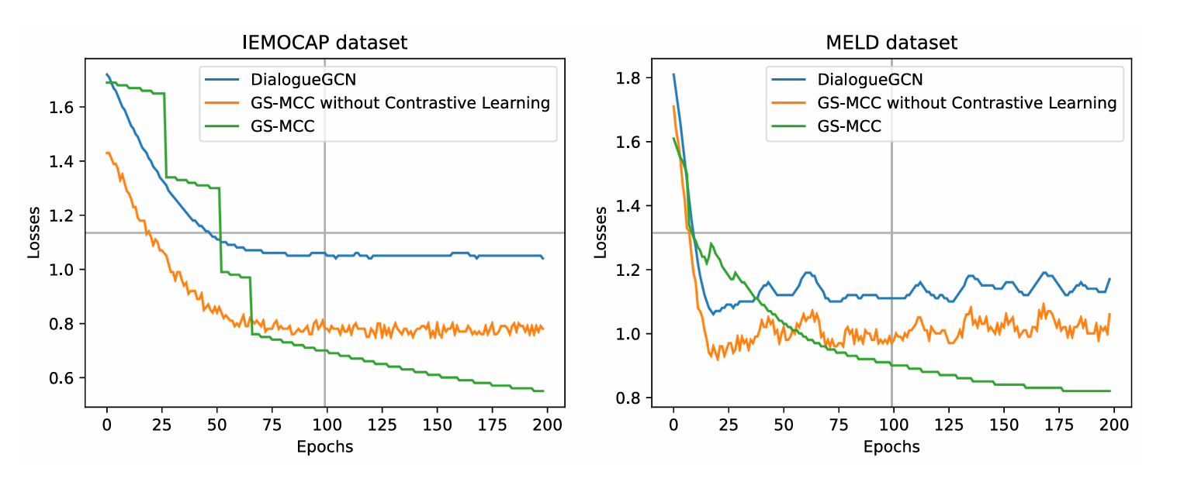
ATAI
Advanced Technique of Artificial Intelligence
ATAI
ChongqingUniversity _{AdvancedTechniqueof}
of Technology Artificial Intelligence
Chongqing University of
Technology
Chongqing University ^{ATAI}
_{of Technology} Advanced Techniqueof
Artificial Intelligence
Chongqing University of Technology
Chongqing University of Technology
Experiments

Slide 11
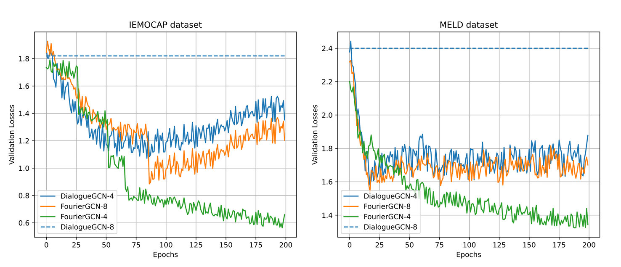
ATAI
Advanced Technique of Artificial Intelligence
ATAI
ChongqingUniversity _{AdvancedTechniqueof}
of Technology Artificial Intelligence
Chongqing University of
Technology
Chongqing University ^{ATAI}
_{of Technology} Advanced Techniqueof
Artificial Intelligence
Chongqing University of Technology
Chongqing University of Technology
Experiments

Slide 12
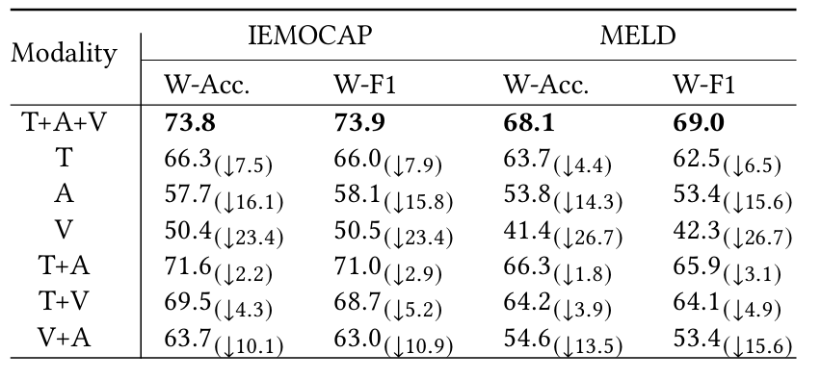
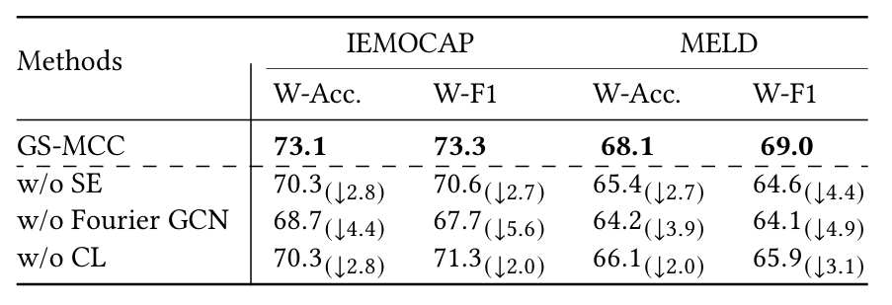
ATAI
Advanced Technique of Artificial Intelligence
ATAI
ChongqingUniversity _{AdvancedTechniqueof}
of Technology Artificial Intelligence
Chongqing University of
Technology
Chongqing University ^{ATAI}
_{of Technology} Advanced Techniqueof
Artificial Intelligence
Chongqing University of Technology
Chongqing University of Technology
Experiments

Slide 13


ATAI
Advanced Technique of Artificial Intelligence
ATAI
ChongqingUniversity _{AdvancedTechniqueof}
of Technology Artificial Intelligence
Chongqing University of
Technology
Chongqing University ^{ATAI}
_{of Technology} Advanced Techniqueof
Artificial Intelligence
Chongqing University of Technology
Chongqing University of Technology
Thanks!

